Slide 1
Circulation/ILL Advisory Group
SEPTEMBER 10, 2021

Slide 2
Overview of Circulation/ILL Advisory Group

Slide 3
Circ/ILL Advisory Group
Advisory groups consult with CCS on potential system configuration changes, assist with research and testing, and recommend policy changes and best practices to their associated technical groups.
Advisory group members are expected to:
•Use their expertise and knowledge to represent the CCS community
•Participate in 4 advisory group meetings per year
•Participate in 4 associated technical group meetings per year
•Engage in online, asynchronous conversation and research between meetings
•Work with CCS staff to present findings and recommendations as needed.

Slide 4
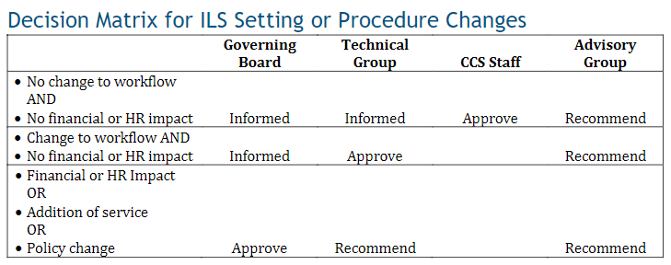

Slide 5
Circ/ILL Advisory Group
2021-2022 Meeting Dates
September 10, 2021 (9:30am) - Zoom
December 10, 2021 (9:30am) - Zoom
March 11, 2022 (9:30am) - TBD
June 10, 2022 (9:30am) - TBD

Slide 6
Claims Workflows

Slide 7
Claims Workflows
Point at which an item is claimed
Local practice varies. Libraries have different practices of when they claim an item – some claim right away as good-faith effort and then do shelf checks, others only claim as last resort.
Because of this, libraries have differing policies on if they will hold a patron accountable (mark item as "Lost" and bill patron) for a claimed item.

Slide 8
Claims Workflows
When should the library remove the item from the patron's record?
Due to the differing practices regarding what point an item is claimed, claiming libraries may not be ready to resolve the item at the same time.
However, the item should be resolved within a reasonable amount of time so that the patron does not have long outstanding claims on their record. (A patron can have up to 5 active claims before their card is hard blocked.)

Slide 9
Discussion 1:
What is the minimum AND maximum amount of time an item should remain as "Claimed" before the library removes the claim from the patron's record?

Slide 10
Claims Workflows
As of late August 2021, there are 1,901 items in the database with a current status of Claims. Breakdown of when the items were claimed:
Items Claimed in... | Number of Unresolved Claims
2021 | 791
2020 | 354
2019 | 149
2018 and earlier | 607
Data taken August 24, 2021

Slide 11
Claims Workflows
1,504 items were claimed and then either recovered or billed to the patron between January-July 2021. 75% of those resolved Claims were resolved within 34 days of becoming Claimed.
Claims Resolved Within.... | Percentage of Items Resolved
7 days | 43.1%
10 days | 50%
34 days | 75%
Data taken August 2, 2021

Slide 12
Claims Workflows
Removing a claimed item without billing the patron
Method 1: Mark the item as “Lost” and then waive the charges.
Method 2: Check the item to remove from the patron’s record and then change the item status to "Missing."

Slide 13
Claims Workflows
Method 1: Mark the item as “Lost” and then waive the charges.
A "Lifetime claims" count remains on the patron's record.
Item's circulation status is now "Lost."
Patron has a waived replacement cost on their record.
Consideration: When are items with a status of "Lost" deleted at the library? When do selectors consider reordering a Lost title?

Slide 14
Claims Workflows
Method 2: Check the item to remove from the patron’s record and then change the item status to "Missing."
A "Lifetime claims" count remains on the patron's record.
Item's circulation status is now "Missing" as of the check in date.
Patron does not have a waive charge entry for this item.
Considerations: When are items with a status of "Missing" deleted at the library? When do selectors consider reordering a Missing title? Would your staff be able to easily update an item status?

Slide 15
Discussion 2:
What is the recommended workflow to remove claimed items from a patron’s record when not holding the patron responsible for the costs?

Slide 16
Claims Workflows
Claiming an item that is already Lost and billed to the patron.
Method 1: Waive the charges.
Method 2: Check in item and check back out to patron; mark item as "Claimed."

Slide 17
Claims Workflows
Method 1: Waive the charges.
Item status remains as "Lost."
Patron has a waived replacement cost on their record.
No active claim on patron's account; no count has been added to patron's lifetime claims.

Slide 18
Claims Workflows
Method 2: Check in item and check back out to patron; mark item as "Claimed."
Item status is updated to "Claimed."
An active claim is now on the patron's account; a count will also be added to their lifetime claims.
The library can resolve claim as per local procedure.

Slide 19
Discussion 3:
What is the recommended workflow to resolve a Lost item that the patron claims to have returned?

Slide 20
Lost and Missing Item Retention

Slide 21
Lost and Missing Item Retention
CCS is evaluating possibility of standardizing how long Lost item records and Missing item records are retained in the database.
Standardization would allow CCS to automate item record deletion.
Since Lost items prevent patron records from being deleted, standardization would also allow CCS and libraries to maintain a cleaner patron database.

Slide 22
Lost and Missing Item Retention
When an item record is deleted
Any pending charges remain on a patron's record. The charge has a [DELETED] note appended to the title. Staff are unable to click into the item record.

Slide 23
Lost and Missing Item Retention
When an item record is deleted
Staff are unable to view item history via Simply Reports or the item record. CCS staff can query historical information (like previous patron).

Slide 24
Lost and Missing Item Retention
18,207 items became Lost and were then recovered (checked in or checked out to a different patron) between January-July 2021. 75% of those recovered Lost items were recovered within 35 days of becoming Lost.
Lost Items Resolved Within.... | Percentage of Items Resolved
7 days | 34.5%
14 days | 50%
35 days | 75%
Data taken August 2, 2021

Slide 25
Lost and Missing Item Retention
8,194 items became Missing and were then recovered between January-July 2021. 75% of those recovered Missing items were recovered within 46 days of becoming Missing.
Missing Items Resolved Within.... | Percentage of Items Resolved
7 days | 31.2%
20 days | 50%
46 days | 75%
Data taken August 2, 2021

Slide 26
Lost and Missing Item Retention
CCS wants to understand how deleted Lost and Missing items records can impact Circulation and ILL staff.
Do staff run into issues with deleted item records in their daily workflows like, for example, when checking in?
How might deleting Lost or Missing items within a certain time period impact Circulation and ILL workflows?
Do staff run into issues with deleted Lost item records when working with patrons?
How might deleting Lost item records at a certain point impact working with patrons?

Slide 27
Lost and Missing Item Retention
CCS wants to understand how deleted Lost and Missing items records can impact Circulation and ILL staff.
If CCS was to look further into standard practices, what information or data would you want in order to form a recommendation?

