Slide 1
ILL Technical Group Meeting
February 24, 2022

Slide 2
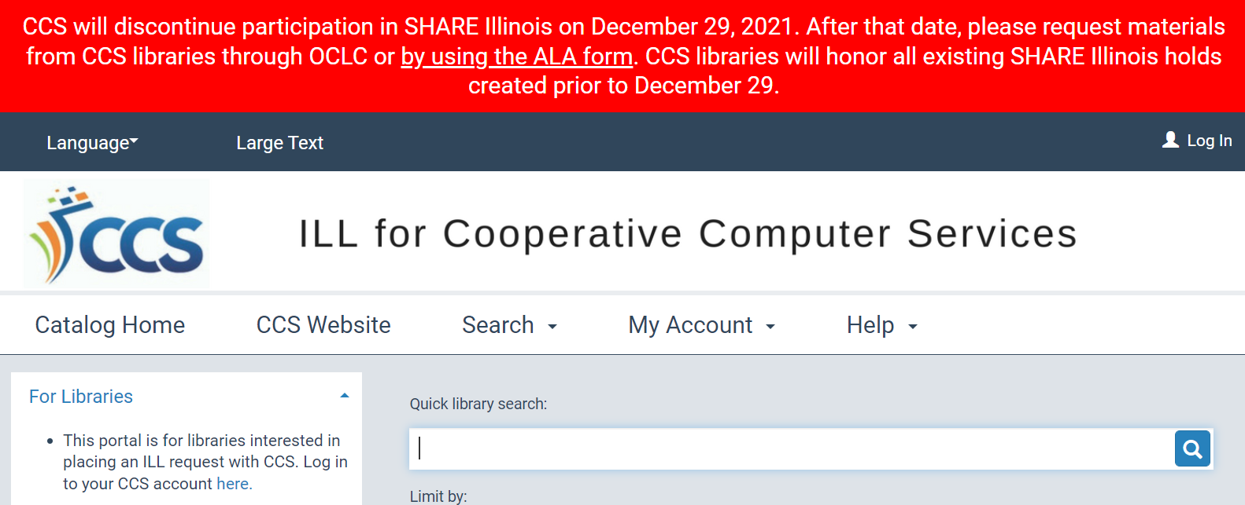
SHARE Illinois Update
Ability to place holds in ILL for Cooperative Computer Services PAC disabled on December 29, 2021

Slide 3
SHARE Illinois Update
Ability to log into ILL for Cooperative Computer Services PAC will be disabled on March 1

Slide 4
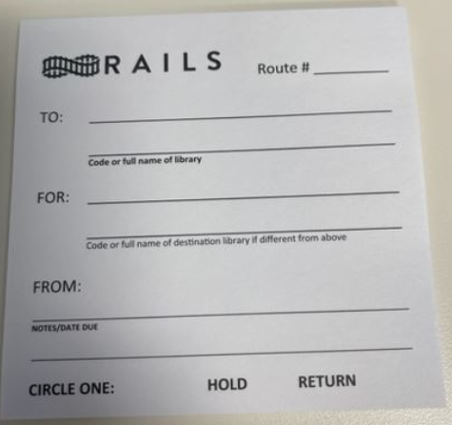
RAILS Transit Slips: Hold/Return

Slide 5
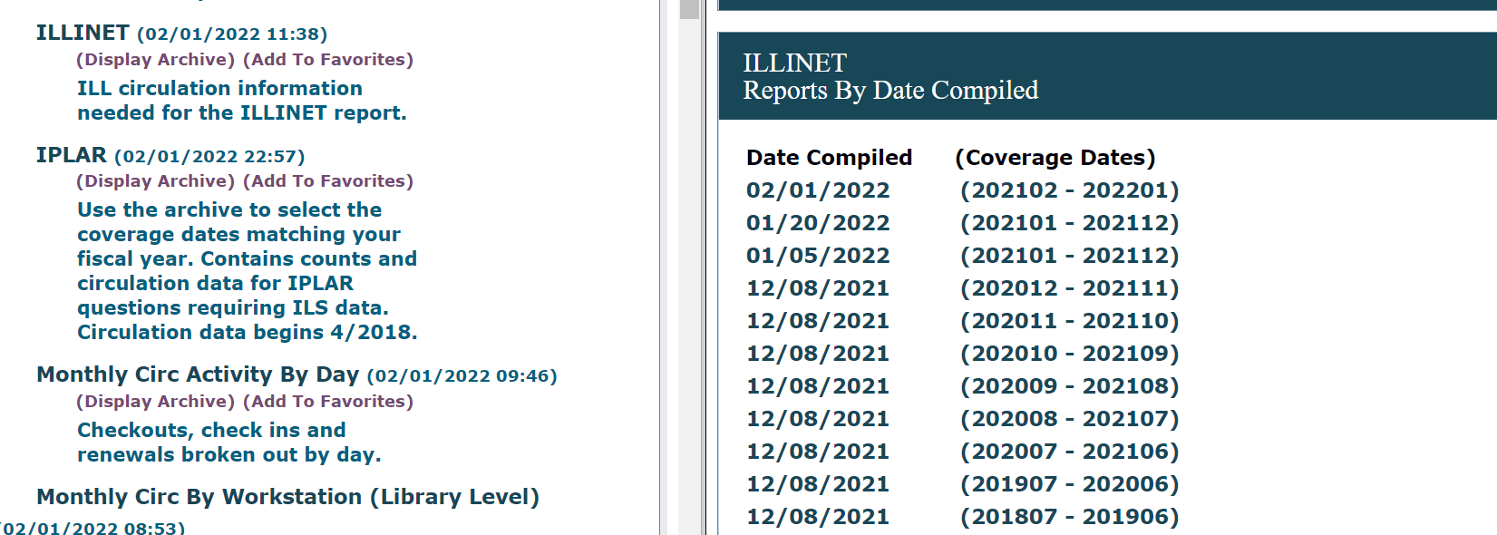
Web Reports: ILLINET

Slide 6
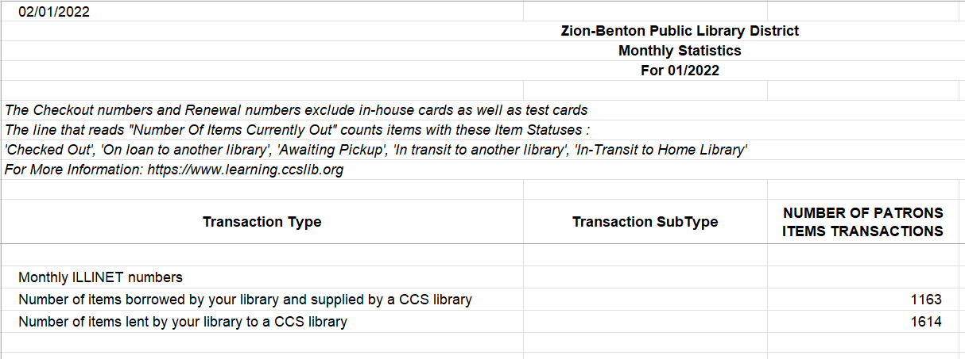
Web Reports: Monthly Circ Dpt Stats

Slide 7
Web Reports: ILLINET
Pull what data we can from ILS based on what ILLINET survey asks for

Slide 8
Web Reports: ILLINET
Some questions on ILLINET asks for number of requests received or sent (not just checkouts)
CCS uses number of Ready for Pickup holds as metric
Holds are counted, even if not checked out

Slide 9
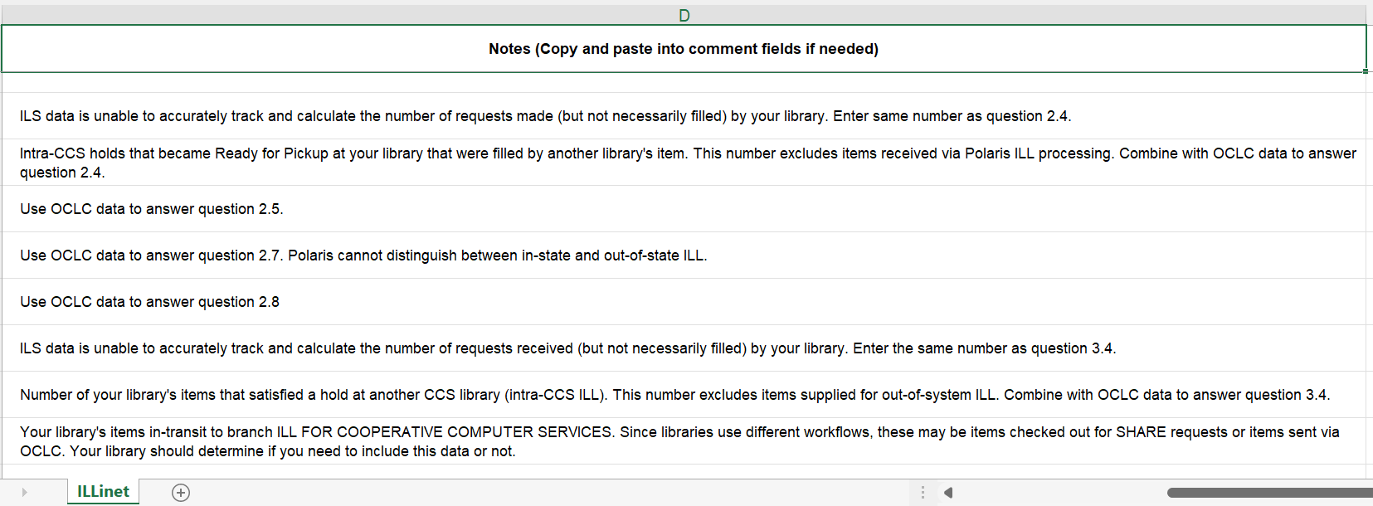
Web Reports: ILLINET

Slide 10
Web Reports: ILLINET vs Monthly ILL
Some questions on ILLINET asks for number of requests received or sent (not just checkouts)
The MONTHLY ILL report counts items sent to other CCS libraries and were checked out
If an item is sent but never checked out, it is not counted in the MONTHLY ILL report

Slide 11
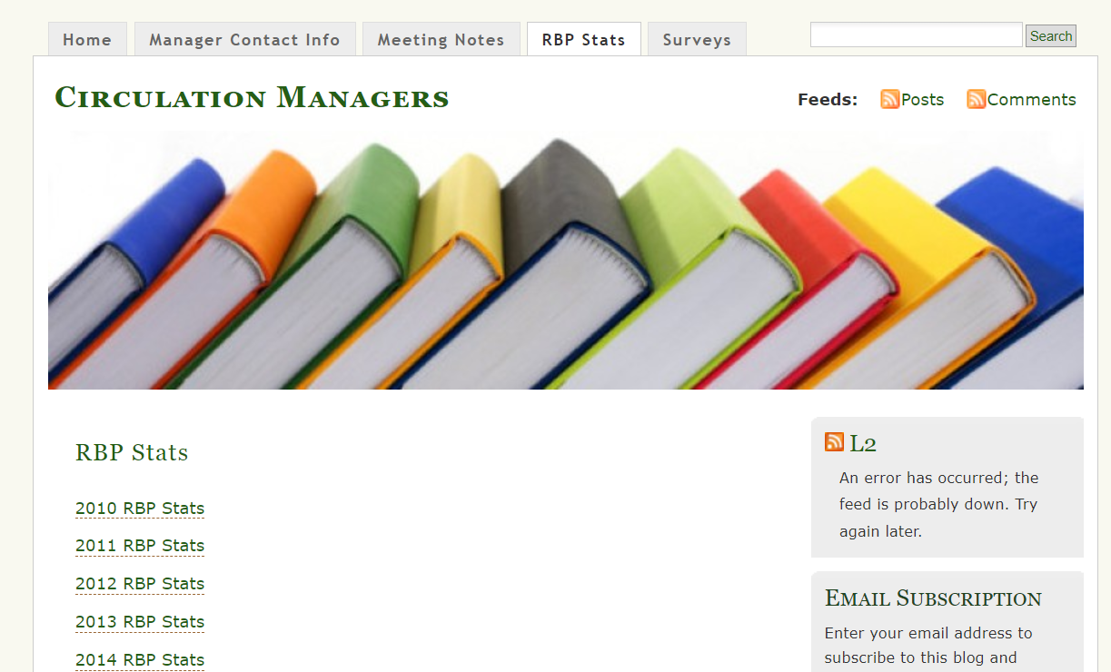
Circulation Managers RBP Stats
Circulation Managers blog compiles reciprocal borrowing stats of group members (formally North Suburban Library System group)
CCS provides a report to the data coordinator on behalf of CCS libraries

Slide 12
Circulation Managers RBP Stats vs Web Reports
Circulation Managers RBP Reports look at reciprocal borrowing activity between group members (former NSLS libraries)
Web Reports RBP reports report on all reciprocal activity

