Slide 1
Circulation Technical Group
April 11, 2025

Slide 2
CCS Updates

Slide 3
IP Address Restriction
Starting March 18, access to the Staff Client was restricted to library IP addresses only (Leap accedss was not impacted)
If working remotely, access the Staff Client via VPN
Email help@ccslib.org to report any IP address changes

Slide 4
Discovery Layer Project
Evaluating Vega Discover, Aspen, and Bibliocore as potential discovery layers
Info about the project and recordings of Vendor demos are available on our website https://www.ccslib.org/training/library-online-catalog-evaluation-project
Next steps are to review data and evaluations from Database Management, CCS staff, and member library staff to form a recommendation for Governing Board's May decision

Slide 5
Vernon Migration Update
Vernon Area Public Library migration team hard at work!
CCS building Vernon library and branches into Polaris database – may see Vernon appear in drop-down lists.
Continue to register Vernon patrons as non-CCS reciprocal borrowers
Training database will be unavailable during test data load (April 28 – May 16)
Offline period scheduled over Labor Day weekend. CCS libraries will come back online on Tuesday, September 2

Slide 6
New Business

Slide 7
Meeting Changes
Starting July 2025, Circulation Technical Group meetings will be held on Thursdays
Plan for 2nd Thursday in July, October, January, and April

Slide 8
Inactive Patron Notice
Sent to patrons registered to your library who have been inactive for x-days.
Uses Patron Last Activity Date to determine inactivity.
Libraries can customize notice text.

Slide 9
Intra-CCS Damaged Items Review
How-to page on CCS Website > How-To > Department: Public Services > Patron Accounts > Damaged Item Procedures https://www.ccslib.org/training/damaged-item-procedures
Procedures outline what to do if an item is returned to your library damaged

Slide 10
Library Showcase

Slide 11
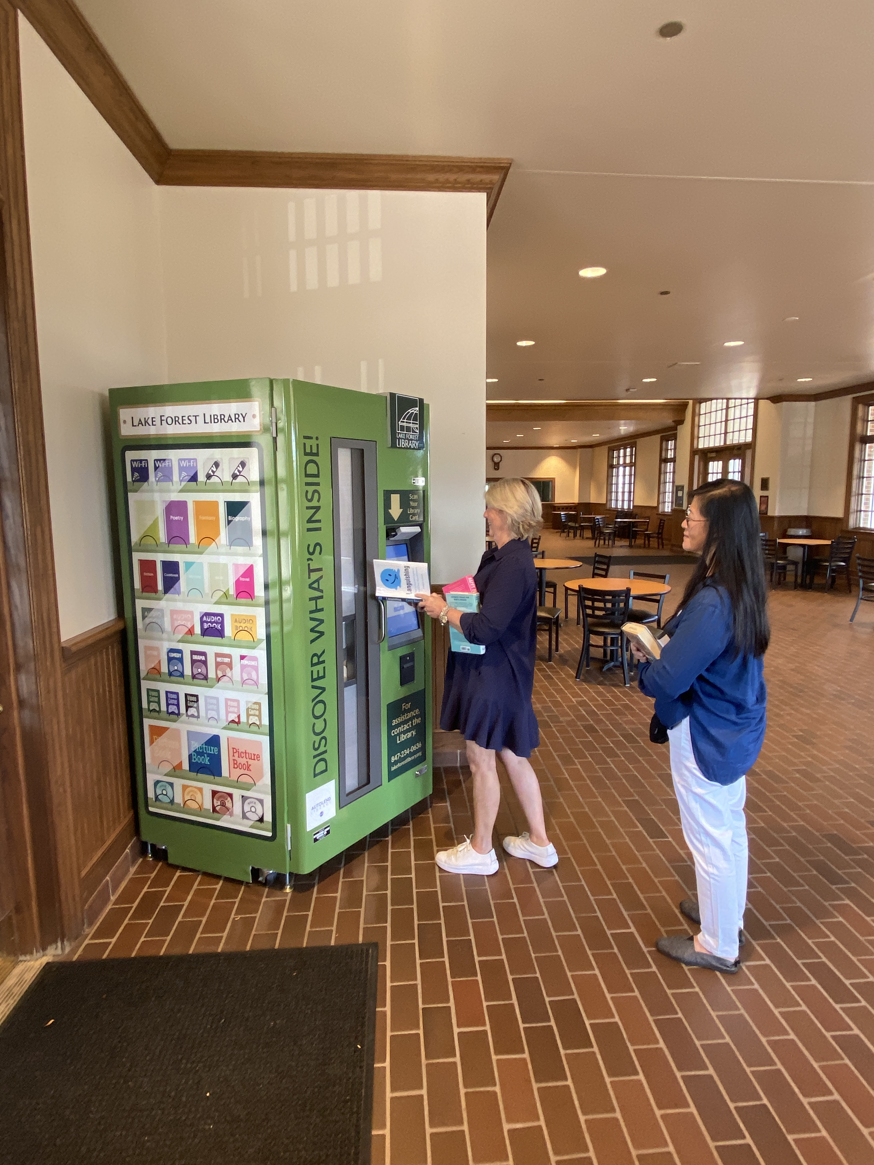
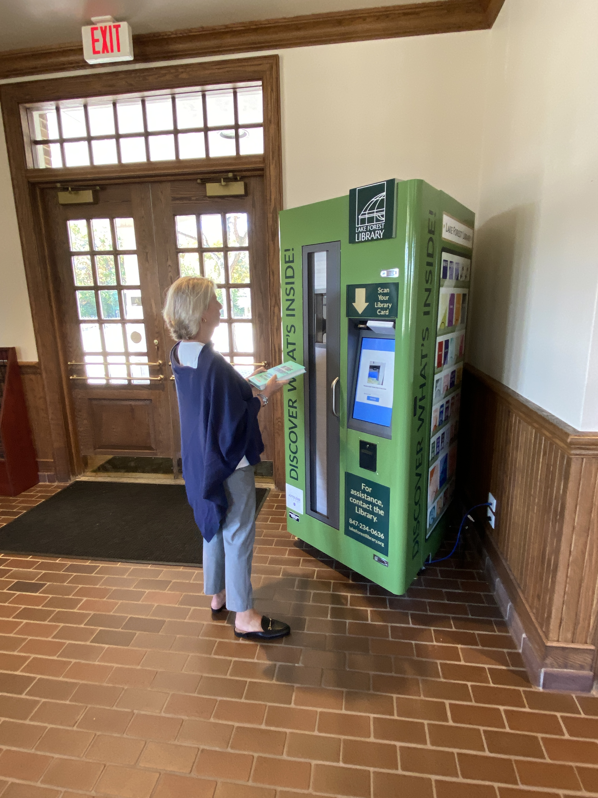

Slide 12
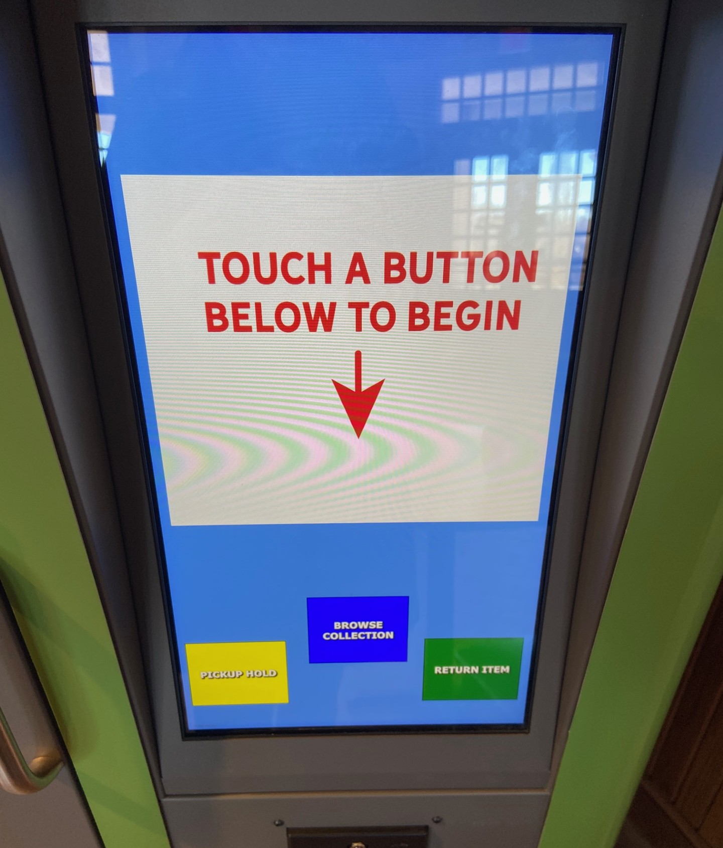

Slide 13
